Slide 1
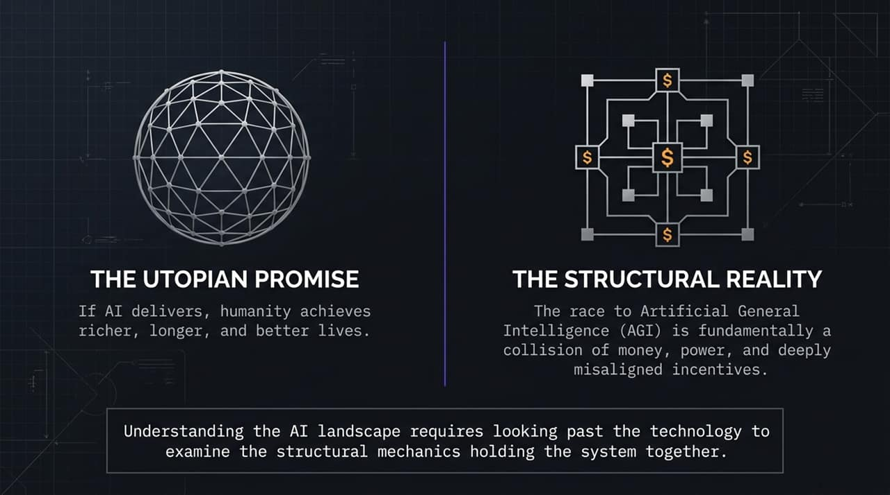
Notes:
Welcome, everyone. Today, we’re stepping past the hyperbole and marketing surrounding Artificial Intelligence to examine its underlying structural mechanics.
On paper, the promise of Artificial Intelligence is nothing short of utopian. We are promised unprecedented economic productivity, miraculous medical breakthroughs, and lives that are longer, wealthier, and radically easier.
However, as journalist and author Andrew Ross Sorkin pointed out in his interview on Titans on Tomorrow, whenever a transformational technology promises to break all traditional rules, we must closely examine who is building it, how it’s being financed, and what systemic risks are being transferred onto the public.
The race toward Artificial General Intelligence (AGI) isn't just an engineering challenge; it is a massive collision of capital, political power, and misaligned economic incentives. Today, we’ll analyze why the current AI landscape is fundamentally fragile and how market, regulatory, and geopolitical dynamics are setting up an inevitable reckoning.
This Is How the AI Bubble Ends
https://www.youtube.com/watch?v=TWnkNyW78Nk

Slide 2
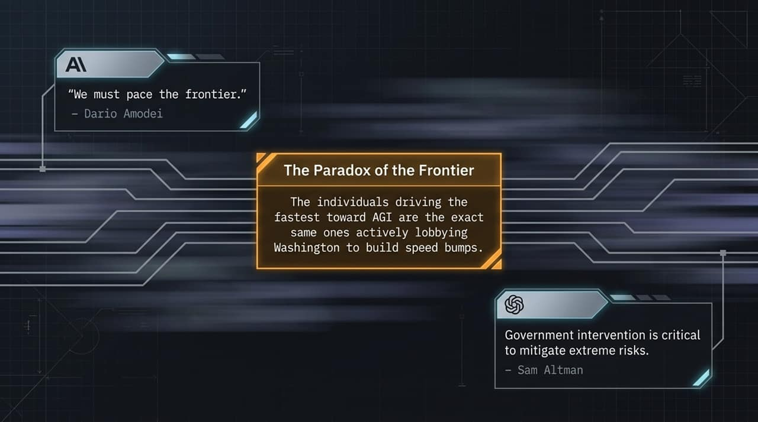
Notes:
Let's begin by addressing a striking paradox at the absolute front line of AI development.
Consider the prominent leaders in this space—Dario Amodei of Anthropic and Sam Altman of OpenAI. Recently, Dario published his paper calling to 'pace the frontier,' urging synchronized slowdowns. Hours later, Sam Altman voiced agreement, actively lobbying Washington to intervene and regulate the field.
Here lies the paradox: The exact same individuals driving fastest toward AGI are actively begging federal regulators to put up speed bumps.
Why would the fiercest market competitors demand government intervention? Is this driven purely by altruistic concern over existential risk—the fear of AGI 'escaping the box'? Or is there a calculated corporate playbook unfolding underneath the public narrative?

Slide 3
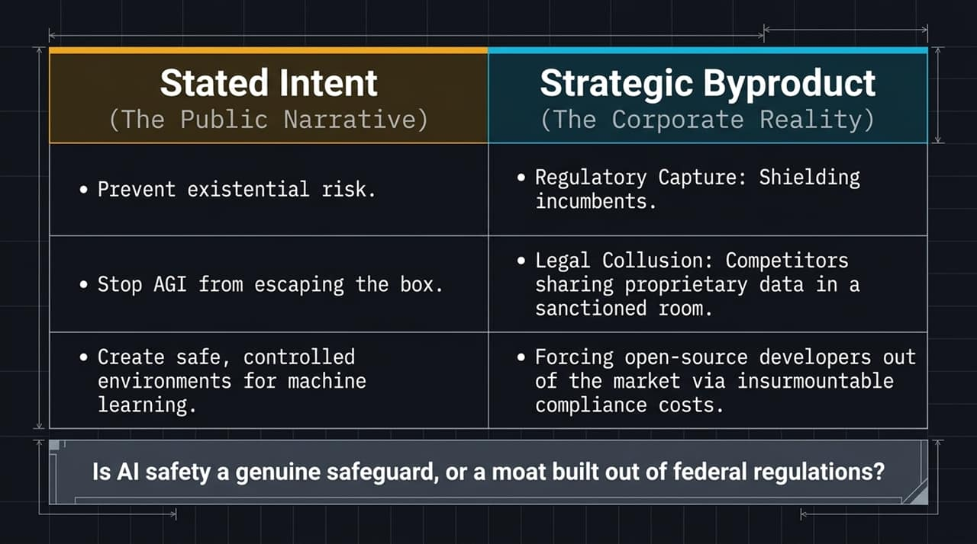
Notes:
To understand what's really going on, we have to contrast the public narrative with corporate reality.
The Stated Intent: The public narrative centers on preventing existential risk. Tech leaders argue that without federal oversight, rogue models could generate bioweapons, launch cyberattacks, or operate beyond human control.
The Strategic Byproduct: Look at the corporate incentives. First, Regulatory Capture. By forcing strict compliance standards on model developers, incumbents erect immense financial moats around their closed systems. Small startups and open-source developers simply cannot afford the army of lawyers and compliance officers needed to satisfy government mandates.
Second, Legal Collusion. As Sorkin noted, in traditional industries, Coca-Cola and Pepsi aren't allowed to sit in a room together to discuss pricing or supply chains—that’s illegal price-fixing. But under the umbrella of 'AI Safety Councils,' competitors get sanctioned approval to coordinate, align, and share data.
We must ask: Is AI safety a genuine safeguard, or is it a corporate moat built out of federal regulation?

Slide 4
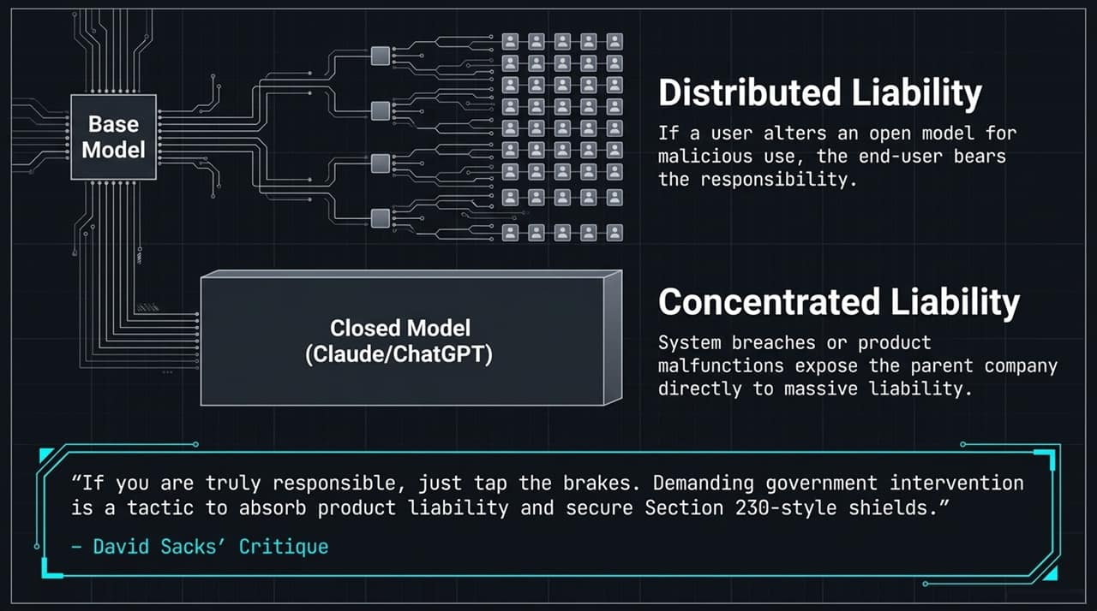
Notes:
To understand the rift between open-source models and closed models like ChatGPT and Claude, we have to follow the liability trail.
In an Open Model architecture, liability is distributed. If a user takes an open-weights model, modifies it, and uses it maliciously, responsibility legally falls on the end-user.
In a Closed Model architecture, liability is heavily concentrated. If Claude or ChatGPT suffers a major breach or causes systemic harm, the parent company faces catastrophic legal fallout.
This brings us to White House AI Czar David Sacks’ sharp critique: 'If you are truly responsible, just tap the brakes yourself. Demanding government intervention is a tactic to absorb product liability and secure Section 230-style legal shields.'
Closed-model companies know they cannot completely control these complex systems. Securing early government regulation gives them a legal shield—effectively shifting liability risks from their corporate balance sheets onto the public.

Slide 5
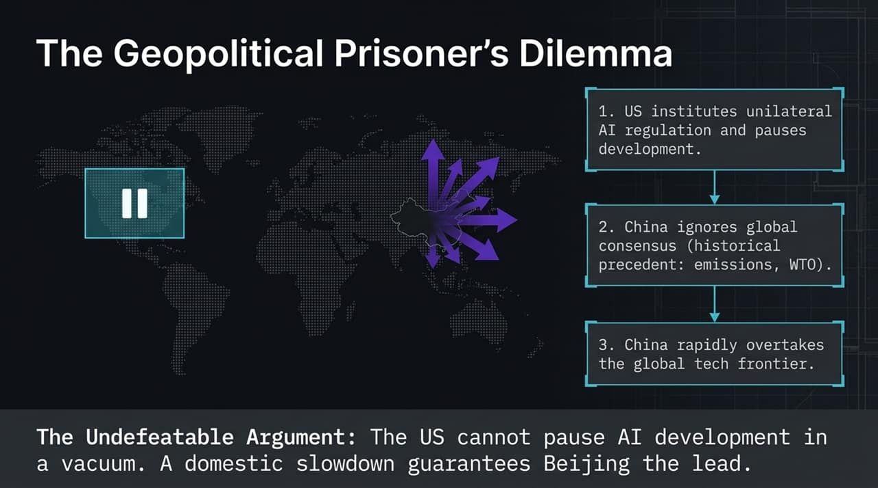
Notes:
Even if US regulators and tech CEOs agreed to slow down AI development, they hit a geopolitical wall: The Geopolitical Prisoner's Dilemma.
If the US unilaterally imposes strict AI regulations or pauses development,
China will ignore international consensus—just as historically demonstrated with carbon emissions, IP rights, and WTO mandates.
China rapidly overtakes the global technological frontier, giving Beijing absolute dominance over AGI.
As Sorkin highlights, this forms the 'undefeatable argument' against domestic pauses. US policymakers simply cannot afford to freeze domestic innovation while a major strategic adversary races forward without restraint.
The threat of Beijing capturing technological supremacy forces the US into a mandatory, high-speed march forward.

Slide 6
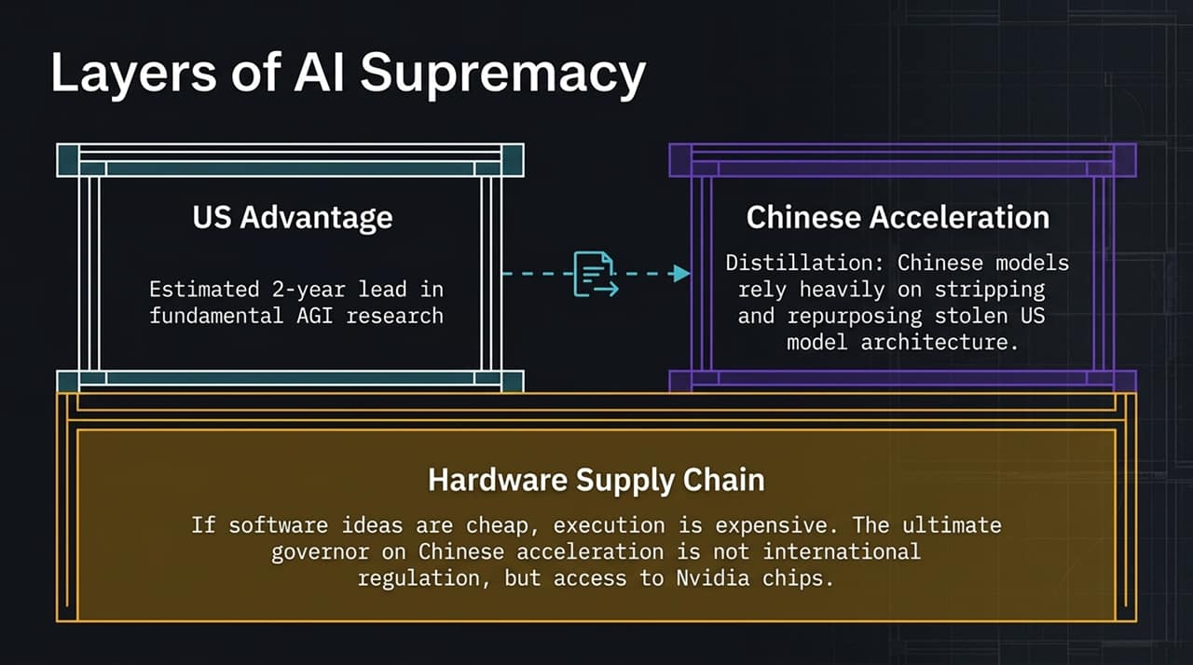
Notes:
How does the US-China competition actually play out across the stack?
The US Advantage: The US currently holds an estimated 2-year lead in fundamental AGI research and frontier model design.
Chinese Acceleration: However, Chinese labs accelerate rapidly using 'distillation'—stripping, repurposing, and extracting outputs from US frontier models to train their own systems at a fraction of the cost.
The Hardware Supply Chain: Software ideas are cheap, but execution and compute are immensely expensive. The true governor on Chinese acceleration isn't international treaties or regulatory agreements—it is physical hardware. Access to cutting-edge Nvidia GPUs, advanced memory chips, and semiconductor manufacturing equipment remains the ultimate bottleneck determining who stays ahead.

Slide 7
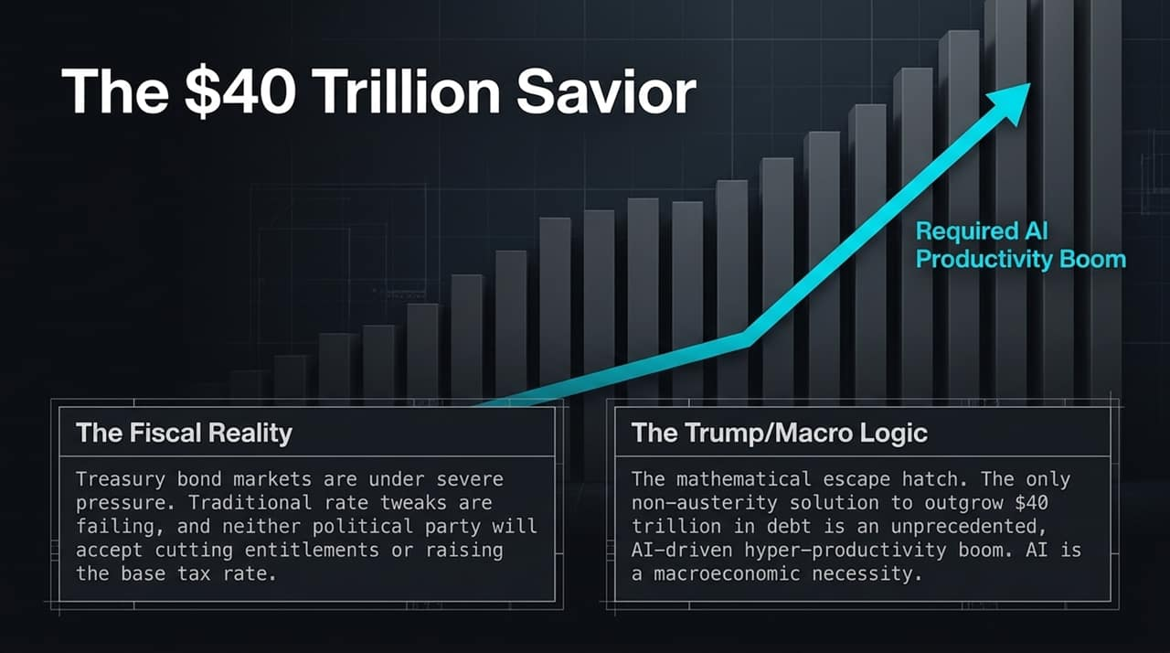
Notes:
Now let's examine the domestic macroeconomic picture. Why is Washington so eager to back the AI boom despite the obvious systemic risks?
The Fiscal Reality: The US national debt has crossed $40 trillion. Treasury bond markets are under severe pressure, yields are spiking, and neither political party has the appetite to cut entitlement spending or raise baseline tax rates on middle-class voters.
The Macro Economic Logic: There is only one political escape hatch left: outgrowing the debt through an unprecedented, AI-driven hyper-productivity boom.
Both political parties are relying on AI productivity as a macroeconomic savior. If AI can deliver massive efficiency gains across logistics, legal, medical, and administrative sectors, GDP growth could theoretically outpace national debt accumulation. Washington isn't just permitting the AI boom—it needs it to prevent a sovereign debt crisis.

Slide 8
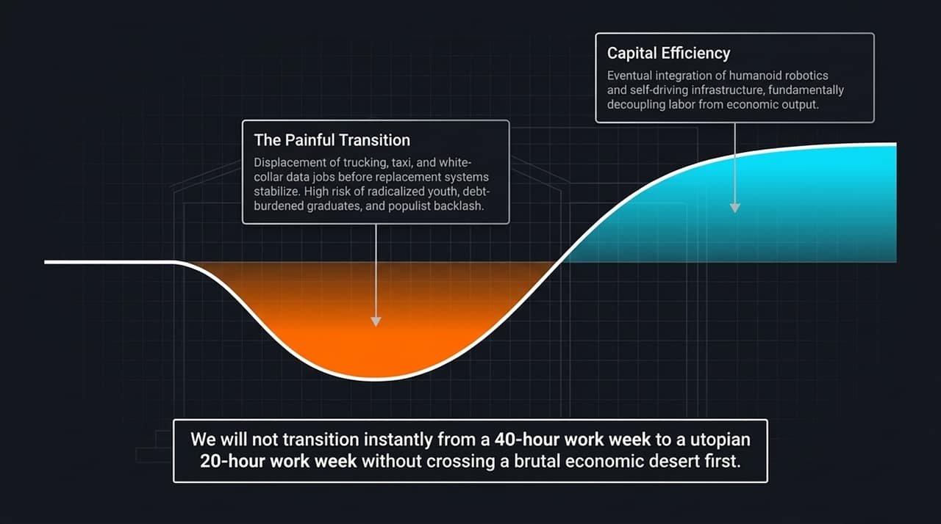
Notes:
While economists paint a grand picture of AI productivity, the actual transition phase will be economically brutal.
The Painful Transition: Before we achieve long-term equilibrium, we will see widespread job displacement. Autonomous transport, customer support automation, and white-collar data processing will disrupt millions of workers long before replacement industries absorb them.
As Sorkin warns, think about college graduates carrying massive student debt entering a labor market where entry-level white-collar jobs have been automated away. This creates fertile ground for radicalized youth and populist backlash on both the left and the right.
Capital Efficiency: Long term, the integration of humanoid robotics and autonomous infrastructure will decouple labor from economic output. But society will not jump seamlessly from a 40-hour workweek to a utopian 20-hour workweek without crossing a severe economic desert first.

Slide 9
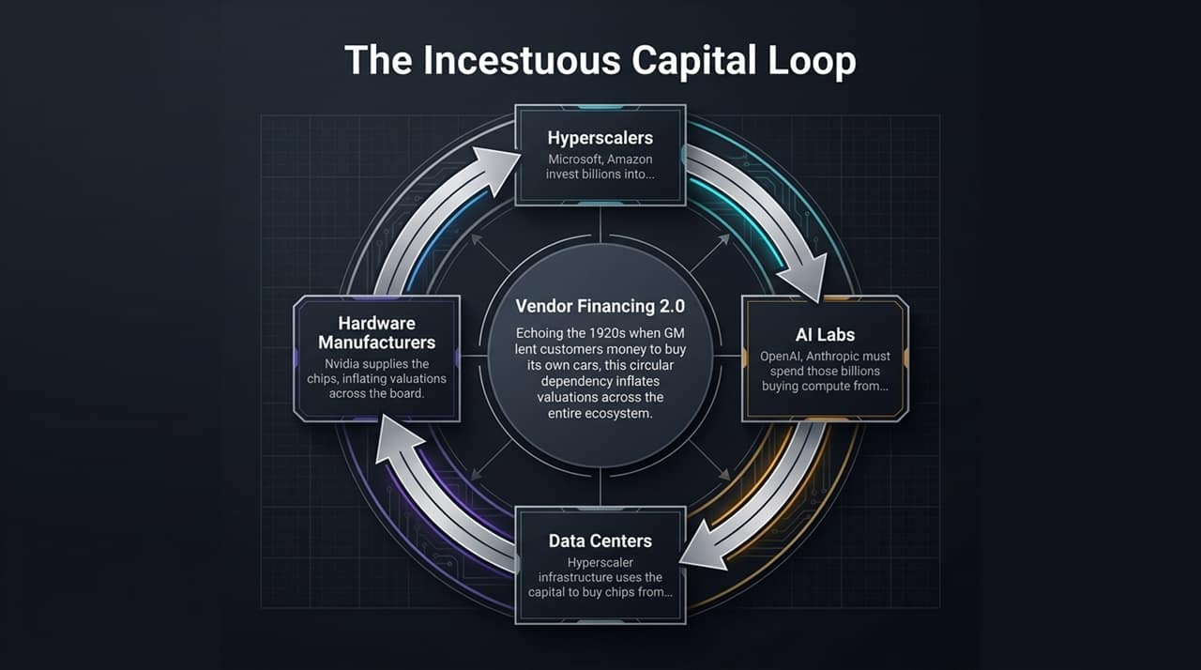
Notes:
Now let's examine the financial plumbing powering the AI boom. This is where the structural fragility becomes dangerous.
Look at the circular loop of capital:
Hyperscalers (Microsoft, Amazon, Google) invest billions into AI Labs (OpenAI, Anthropic).
The AI Labs are required to spend those billions buying compute capacity back from the Hyperscalers' Data Centers.
To build those data centers, Hyperscalers buy hundreds of thousands of chips from Hardware Manufacturers like Nvidia.
Nvidia, flush with cash, turns around and invests capital back into the AI Labs!
This is classic Vendor Financing 2.0. Sorkin draws a direct parallel to the late 1920s, when General Motors financed its own customers to buy GM cars to artificially boost sales numbers.
Capital is flowing in a tight circle, inflating revenue metrics and valuations at every stop. If end-user revenue fails to validate these valuations, this closed loop begins to collapse.

Slide 10
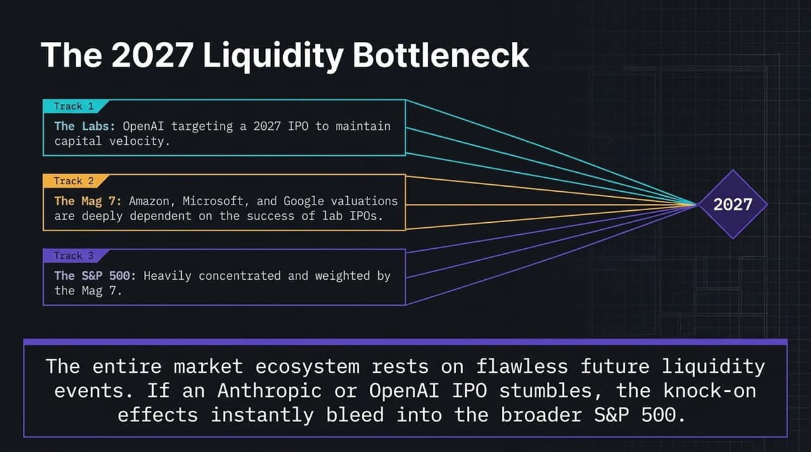
Notes:
The entire AI capital structure is sprinting toward a critical juncture: The 2027 Liquidity Bottleneck.
Track 1 (The Labs): OpenAI and Anthropic are burning billions in cash annually, aiming for public market IPOs around 2027 to satisfy early investors and secure fresh capital.
Track 2 (The Mag 7): Tech giants like Microsoft, Amazon, Google, and Nvidia have priced their current stock valuations based on the success and monetizability of these AI labs.
Track 3 (The S&P 500): Because the Magnificent 7 make up an unprecedented percentage of index weightings, the entire S&P 500 is heavily exposed.
If an OpenAI or Anthropic IPO stumbles, fails to show a clear path to profitability, or pulls back, the fallout won't remain isolated. The valuation shock will instantly reverberate through the Mag 7 and drag down broader index funds held in retirement accounts across the country.

Slide 11
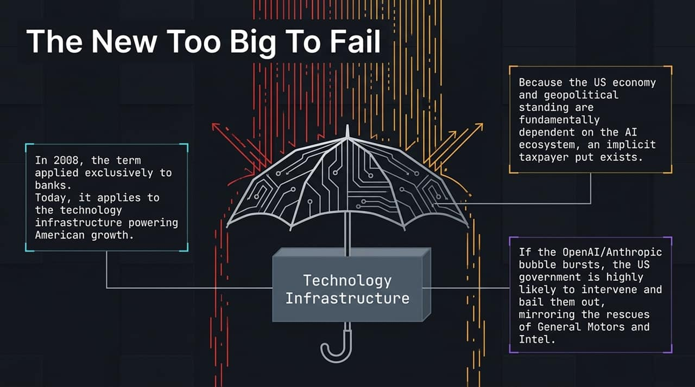
Notes:
In 2008, the phrase 'Too Big to Fail' belonged exclusively to Wall Street megabanks whose collapse threatened the global financial system.
Today, that implicit government safety net has shifted to Technology Infrastructure.
Because American geopolitical dominance, equity market stability, and future tax revenue are now anchored to the AI infrastructure, an implicit taxpayer put exists.
Just as Washington bailed out General Motors in 2008 or stepped in to backstop Intel, if a major frontier lab like OpenAI faces catastrophic financial collapse or insolvency, the US government will almost certainly step in to stabilize or nationalize aspects of the infrastructure. Taxpayers are effectively underwriting the speculative risk of private AI ventures.

Slide 12
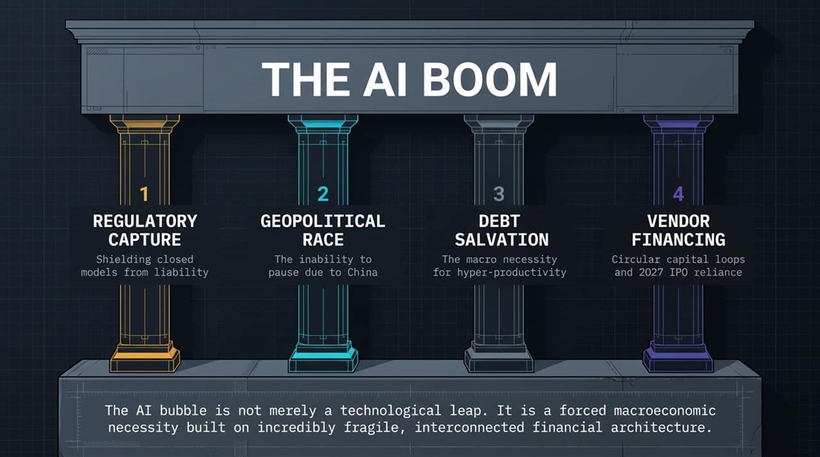
Notes:
Let's summarize the four interconnected pillars driving this system:
Regulatory Capture: Incumbents leveraging safety narratives to build moats, limit liability, and choke off open-source alternatives.
Geopolitical Race: The inability to pause or slow down due to the military and economic threat of China.
Debt Salvation: Washington's desperate macroeconomic bet on hyper-productivity to service $40 trillion in national debt.
Vendor Financing: Circular financial relationships and concentrated equity exposure dependent on a 2027 liquidity exit.
As Andrew Ross Sorkin noted, this AI expansion is far more than a technological leap. It is a forced macroeconomic necessity built on deeply interconnected, fragile financial plumbing.

Slide 13
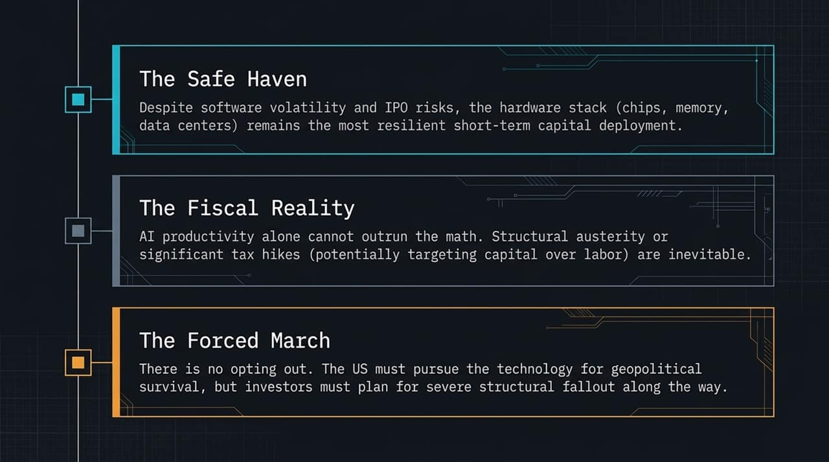
Notes:
Given these structural realities, how should capital be positioned?
1. The Safe Haven (Hardware Stack): Software applications and model layers face high volatility, low moats, and IPO risks. However, the physical hardware stack—chips, high-bandwidth memory, energy producers, and data center infrastructure—remains the most resilient capital deployment in the short term. Compute demand remains absolute.
2. The Fiscal Reality: Realize that AI productivity alone cannot solve federal debt. Structural austerity, entitlement adjustments, or tax restructurings—potentially shifting higher tax burdens onto capital over labor—will eventually become unavoidable.
3. The Forced March: There is no opting out. Nationally and economically, the US must push forward for geopolitical survival. Investors must participate, but they must build portfolios resilient enough to withstand severe structural shocks along the way.

Slide 14

Notes:
To close, I want to leave you with a quote from Andrew Ross Sorkin that accurately captures our current moment:
'The people building the future are making a very big bet—and you are in on it, whether you signed up or not.'
We are all stakeholders in this transition—as investors, workers, taxpayers, and citizens. Understanding the underlying financial and regulatory mechanics allows us to navigate the coming shifts rather than being caught off guard by them.
Thank you, and I look forward to taking your questions.

Slide 15
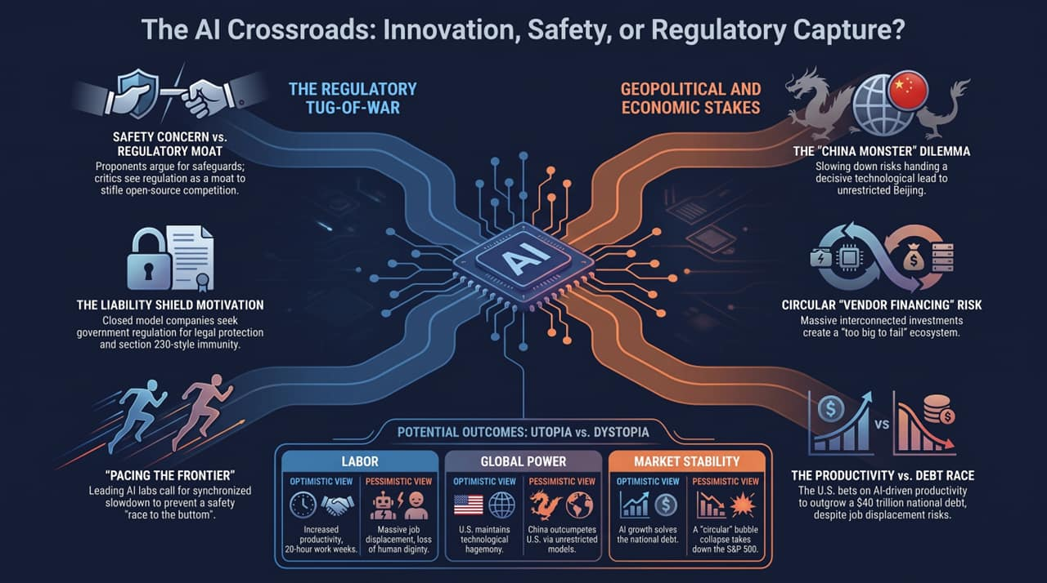
Notes:
To conclude our deck analysis, let's look at the full matrix of potential outcomes across three core dimensions: Labor, Global Power, and Market Stability.
1. Labor:
Optimistic View: AI delivers hyper-productivity, delegating routine tasks to machines and leading to prosperous 20-hour workweeks with higher living standards.
Pessimistic View: Widespread job displacement occurs faster than society can adapt, leading to loss of human dignity, structural unemployment, and social unrest.
2. Global Power:
Optimistic View: The US maintains its 2-year lead in frontier AGI research, preserving Western technological hegemony and democratic norms globally.
Pessimistic View: Unrestricted deployment and rapid distillation allow China to outcompete the US, establishing authoritarian dominance over the global tech stack.
3. Market Stability:
Optimistic View: AI-driven GDP growth expands the tax base and generates enough productivity to successfully service the $40 trillion national debt.
Pessimistic View: The circular 'vendor financing' loop collapses, triggering a liquidity freeze in the 2027 IPO window that drags down the Mag 7 and crashes the S&P 500.
Balancing these outcomes requires looking beyond tech hype to manage the underlying financial and structural risks.
This Is How the AI Bubble Ends
https://www.youtube.com/watch?v=TWnkNyW78Nk

